Slide 1
Data Abstraction
1-‹#›
Notes:
‹#›

Slide 2
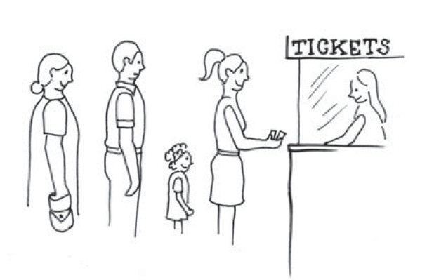

Introduction
Queue
Stack
First in first out (FIFO)
Last in first out / First in last out (FILO)
1-‹#›

Slide 3


Introduction
List/Array
Bag
Ordered
Access randomly
Unordered
Access randomly?
1-‹#›

Slide 4

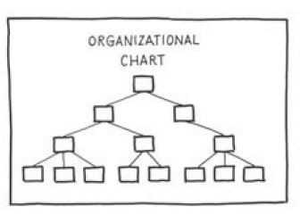
Introduction
Dictionary/Indexing
Tree/Chart
Lookup by word
Word can be organized in alphabetical order
Organizes its entries according to some hierarchy
1-‹#›

Slide 5
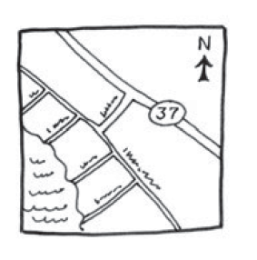
Introduction
Graph
Is a generalization of the ADT tree
1-‹#›

Slide 6
Introduction
Computer programs need to organize their data. These ways of organizing data are represented by abstract data types
Data set
Operations
A collection is an ADT that contains a group of objects
Array
List
Bag
Stack
Queue
Dictionary
Tree
Graph
1-‹#›

Slide 7
Computer Data Type
Primitive types: int, long, float…
System built-in types: Integer, Long, Float…
How about System?
User defined types: Student, Address
Student[] students = new Student[50];
static class Address{ String country; String province; String city; String address; } | static class Student{ String name; Date birthday; String email; Address address1; Address address2; }
1-‹#›

Slide 8
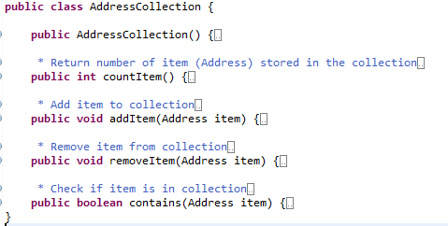
Data Abstraction
Is the way we can capture the behavior of an object or "outside view" of an object
=> Abstract Data Type
1-‹#›

Slide 9
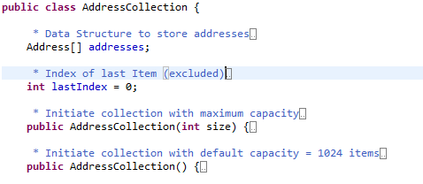
Data Structures
Our goal this term is to spend our time talking about different data structures, algorithms to solve problems, and how to measure the efficiency of the approaches taken
‹#›

Slide 10
Data Structures vs. ADT?
So, what is the difference between a data structure and an abstract data type?
A data structure specifies how we store the data (like an array, linked list)
An abstract data type (ADT) specifies how a new data type behaves: it includes the data and operations that the new data type requires; the data being stored in a data structure!
‹#›

Slide 11
Data Structures vs. ADT?
So, what is the difference between:
Data Abstraction
Abstract Data Type
Data Structure
‹#›

Slide 12
Using Classes to build ADTs
We will use class construct to build abstract data types
The data are placed in the private section
The operations (what the “client” or application can do) is in the public section
‹#›

Slide 13
Using Classes to build ADTs
The user & client should not be aware of what data structure is being used
This means the client program should not be aware that there is a node or a next pointer for a linked list, or an index to an array -- if an array is used
This allows an ADT to “plug and play” different data structures, to maximize efficiency w/o disrupting the client program
‹#›

Slide 14
Using Classes to build ADTs
Given this, what do you think we should do about:
data members?
error messages?
input of data?
output of data?
prompting?
‹#›

Slide 15
Using Classes to build ADTs
For each data member, ask yourself the question....could this be a local variable to a member function instead?
If the value of the variable does not need to persist from operation to operation, it should not be a data member!
‹#›

Slide 16
Definition vs. Implementation
Interface
public interface IPerson {
String getFullname();
String toString();
}
Class
1-‹#›

Slide 17
public class Person implements IPerson {
String name;
String lastName;
Date birthday;
Person(String name, Date birthday) {
this.name = name;
this.birthday = birthday;
}
@Override
public String getFullname() {
return lastName + " " + name;
}
...
1-‹#›

Slide 18
Programming Paradigms
Procedural Abstraction
Is the process of writing functions in relative isolation from one another: knowing WHAT each one will do but not necessarily HOW each procedure will do it.
Modular Abstraction
A module contains the data and the procedures allowed to operate on the data 🡺 Hide internal structure of the data, allow programmer access this data through the specified procedures.
‹#›

Slide 19
Programming Paradigms
Data Abstraction
Data abstraction is used as a tool to increase the modularity of a program. It is used to build "walls" between a program and its data structures.
Data abstraction makes us think about what we can do to collections of data and not how to do it.
Object Oriented Programming
The major elements of the object model are abstraction, encapsulation, modularity, hierarchy, and overloading.
‹#›

